Slide 1
20MCA102-Advanced Database Management Systems
Abraham Silberschatz , Henry F. Korth, S.Sudarshan

Slide 2
Examples
Using Library
Purchases from SuperMarket
Purchases Using Credit Card
Using Internet
Studying at University

Slide 3
Definition
Database Management system is a collection of interrelated data and a set of programs to access and manipulate those data.
The primary goal of DBMS is to provide a way to store and retrieve database information,that is both convenient and efficient.

Slide 4
Database System Applications
Banking
Airlines
Credit Card Transactions
Telecommunications
Sales
Human Resources

Slide 5
Database Systems versus File Systems-Purpose of Database Systems
Data Redundancy and Inconsistency
Since different programmers create the file and application programs over a long period,the files may be in different formats and may be written in several programming languages.The same information may be duplicated.
Difficulty in accessing data
Data isolation

Slide 6
Integrity problems-Database Integrity refers to the consistency and accuracy of data.
Atomicity problem-’All or None Property’.Either the transaction should happen in all or nothing should happen.The database should restore to a state that existed prior to this transaction.It is difficult to achieve atomicity in file processing systems.
Concurrent-access anomalies
Security-Data should be secured from anauthorised access.
Data Dependence-The physical structure and storage of the data files and records are defined in the application code.This characteristic of file based system is known as program-data dependence.

Slide 7
Database Users and administrators
Four types of Database users
Naive Users-are unsophisticated users who interact with the system by invoking one of the application programs that have been written previously.
Application Programmers-who write Application Programs
Sophisticated Users-They interact with the system without writing programs.
Specialised users-They write specialised database applications that do not fit into traditional data processing frame work.

Slide 8
Instances and Schemas
Schema – the logical structure of the database
Example: The database consists of information about a set of students and marks and the relationship between them)
Physical schema: database design at the physical level
Logical schema: database design at the logical level
Instance – the actual content of the database at a particular point in time

Slide 9
Database Administrator
A database administrator has central control over both the data and the programs to access those data.The functions include-
Schema definition
Storage structure and access-method definition
Schema and Physical organisation modification

Slide 10
Granting of authorisation for data access.
Routine maintenance.

Slide 11
Levels of Abstraction
The process of hiding irrelevant details from user is called data abstraction.
Physical level: lowest level of data abstraction.describes how a record (e.g., customer) is stored.
Logical level: describes what data stored in database, and the relationships among the data.
type student = record
rollno : integer; student_name : string; student_street : string; student_city : string;
end;

Slide 12
View level:describes highest level of data abstraction.
Views can also hide information (such as an employee’s salary) for security purposes.
Users can just view the data and interact with the database, storage and implementation details are hidden from them.

Slide 13
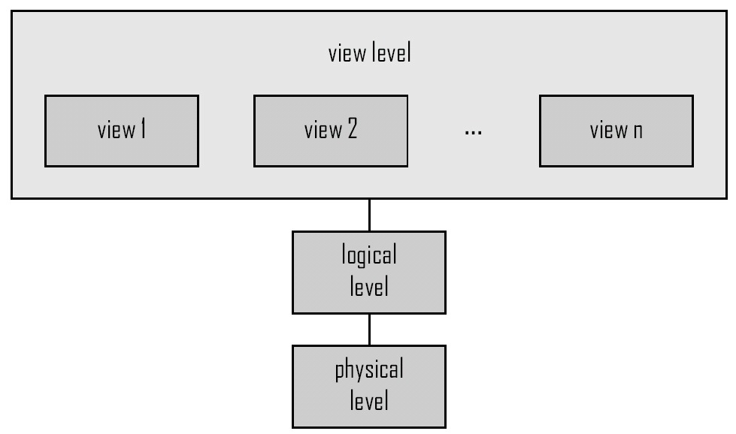
Levels of Abstraction

Slide 14
Keys
Keys help you uniquely identify a row in a table by a combination of one or more columns in that table.
Primary Key-A column or columns that is used to uniquely identify each record in a table.For eg,Rollno column or attribute can uniquely identify each student record in a student table.
The conditions for a primary key are:
A primary key does not accept null values.
The values in a primary key should not be duplicated.

Slide 15
A table can have maximum only one primary key.
Unique key
A unique key is used to uniquely identify each record in a table.For eg,rollno field in a student table can act as a unique key.The conditions are:
A table can have more than one unique key

Slide 16
A unique key accepts null values.
Foreign key
A foreign key refers the primary key value of another table,there by establishing link between the tables
S2 MCA-rollno name address rollno-primary key
1 XXX Tvm
2 xxx Tvm

Slide 17
3 xxx Palghat
....
...
29 xxx Tvm
S2 MCA-Grade-Rollno foreign key
Rollno grade
1 A
2 A+

Slide 18
3 A+
....
....
29 A+
The primary key table is called referenced table or referenced relationand the foreign key table is called referencing table or referencing relation.

Slide 19
Super key
Super key is a single column or a group of multiple columns that can uniquely identify tuples in a table.
Eg-a student table containing attributes like rollno,name,address,emailid.Superkey is {rollno},{rollno,name},{rollno,emailid}{rollno,name,emailid}etc..

Slide 20
Candidate key
A minimal superkey is termed as a Candidate Key.For eg,in the studemt table-{rollno} is a candidate key from the sets{rollno,name},{rollno,address}etc.
Alternate Key
It is a column or group of columns in a table that uniquely identifies every row in that table.A table can have multiple choices for

Slide 21
A key,but only one can be set as the primary key.All the keys which are not primary key are called as alternate keys.

Slide 22
Database Languages
A DBMS provides a data definition language to specify the database schema and a data manipulation language to express database queries and updates.Additionally,it has Transaction Control Langauge and Data Control Language.
DDL-Data Definition Lnguage
DML-Data Manipulation Language
TCL-Transaction Control LAnguage
DCL-Data Control Language
DDL Commands
Create
Alter
Drop
truncate
Create-Syntax
SQL>create table <tablename>(column name1 datatype,columnname2 datatype,......columnnamen datatype);

Slide 23
Eg-
SQL>Create table S3MCA(rollno number(3),name char(15),address char(15));
SQL>Table Created.
Data Dictionary
It contains Meta data.

Slide 24
Alter-Syntax
alter table<table name> add(attribute-1 datatype, attribute-2 datatype, …attribute-n datatype);
SQL>alter table S3MCA add (marks number(3))
SQL>Table altered.
Drop-Syntax
drop table <tablename>;
Eg-SQL>drop table S3MCA;

Slide 25
Truncate
It is used to remove all the records from a table. It deletes all the records from an existing table but not the table itself. The structure or schema of the table is preserved.
Syntax
Truncate table <tablename>;
Eg-truncate table <S3MCA>;
Data Manipulation Language- divided into
a)Procedural DML-It tells,what data is needed and exactly how to get those data.
Eg-Relational Algebra

Slide 26
Non Procedural DML-It tells,what data is needed,without specifying how to get those data.
Eg-Tuple Relational Calculus,Domain Relational Calculus

Slide 27
DML Commands
insert
update
delete
select
Insert-Syntax
SQL>insert into <tablename> values(value1,value2,..valuen);

Slide 28
Eg-
SQL>insert into S3MCA values(1,’Abhirami’,’TVM’);
For inserting bulk of data,we use
SQL>insert into <tablename>values(&variablename1,’&variablename2’....variablenamen);
SQL>insert into S3MCA values(&rollno,’&name’,’&address’);

Slide 29
Update-Syntax
update <tablename>set columnname=value where<condition>;
Eg-update S3MCA set rollno=7 where name=‘Vismaya’);
delete
delete from <tablename>;
delete from <tablename>where <cond>;

Slide 30
Eg-
SQL>delete from S3MCA;
Or
SQL>delete from S3MCA where address=‘TVM’;
Select-syntax
Select * from <tablename>;
Select * from S3MCA;
TCL commands
commit-Syntax
SQL>commit;

Slide 31
Rollback-Syntax
SQL>rollback;
DCL-Data Control Language
grant-Syntax
SQL>grant <privileges>on <tablename>to <username>;
Eg-
grant select,update on S3MCA to student;

Slide 32
Revoke-Syntax
SQL>revoke <privileges>on <tablename> from <username>;
Eg-revoke update on S3MCA from student;

Slide 33
Data Models
A collection of tools for describing
Data
Data relationships
Data semantics
Data constraints
Entity-Relationship data model (mainly for database design)
Relational model
Object-based data models (Object-oriented and Object-relational)
Other older models:
Network model
Hierarchical model

Slide 34
The Entity-Relationship Model
Models an enterprise as a collection of entities and relationships
Entity: a “thing” or “object” in the enterprise that is distinguishable from other objects
Described by a set of attributes
Relationship: an association among several entities
The set of all entities of the same type are termed as entity set.
-The set of all relationship of the same type are refered as relationship set.
Represented diagrammatically by an entity-relationship diagram:
The components or symbols include:
Rectangles-which represents entities
Ellipses which represent attributes
Diamonds-which repreent relationships among entity sets
Lines,which link attributes to entity sets and entity sets to relationships

Slide 35
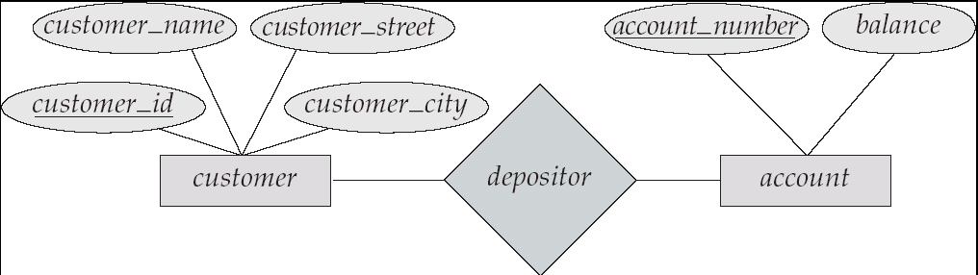

Slide 36
Entity Sets
A database can be modeled as:
a collection of entities,
relationship among entities.
An entity is an object that exists and is distinguishable from other objects.
Example: specific person, company, event, plant
Entities have attributes
Example: people have names and addresses
An entity set is a set of entities of the same type that share the same properties.
Example: set of all persons, companies, trees, holidays

Slide 37
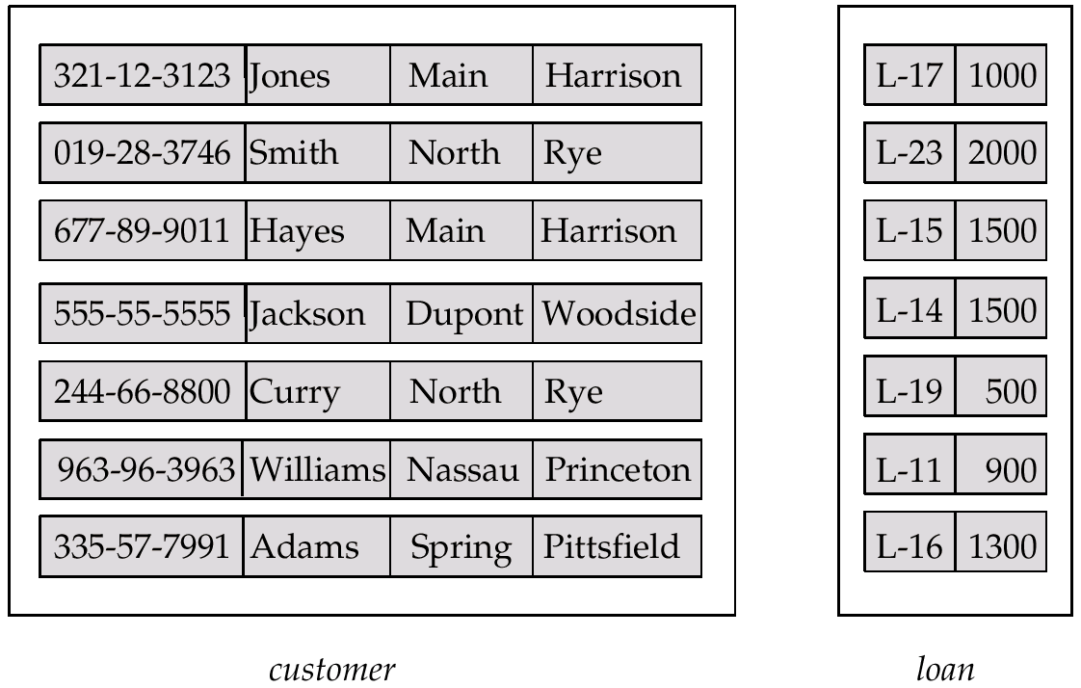
Entity Sets customer and loan

Slide 38
Relationship Sets
A relationship is an association among several entities
Example: Hayes depositor A-102 customer entity relationship set account entity
A relationship set is a mathematical relation among n ≥ 2 entities, each taken from entity sets
{(e₁, e₂, … e_{n}) | e₁ ∈ E₁, e₂ ∈ E₂, …, e_{n} ∈ E_{n}} where (e₁, e₂, …, e_{n}) is a relationship
Example:
(Hayes, A-102) ∈ depositor

Slide 39
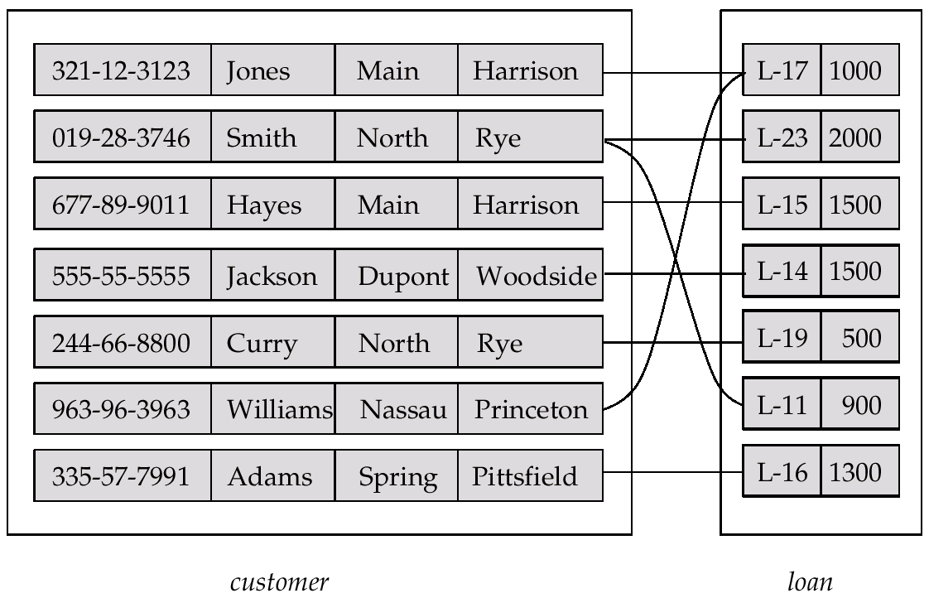
Relationship Set borrower

Slide 40
Relational Model
The Relational Model uses a collection of tables to represent both data and the relationships among data.
Each table has multiple columns and each column has a unique name.
The relational model is a type of Record based Model

Slide 41
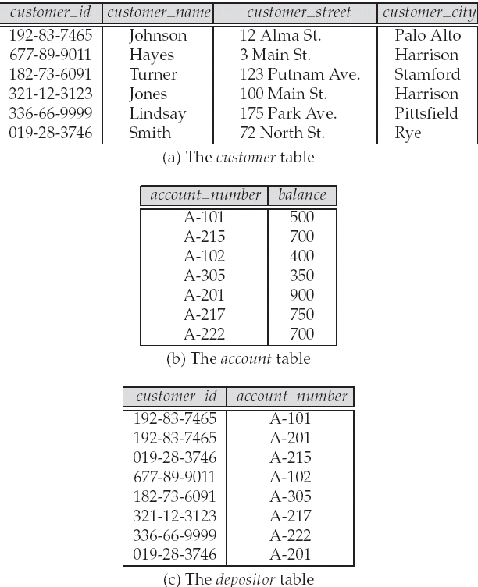
A Sample Relational Database

Slide 42
Object Oriented data model
The object oriented model is a extending the E-R Model with notions of encapsulation,methods(functions)and object identity.
The object relational model combines features of object oriented data model and relational data model.

Slide 43
Attributes
Entities are represented by means of their properties, called attributes. All attributes have values. For example, a student entity may have name, class, and age as attributes.
There exists a domain or range of values that can be assigned to attributes.

Slide 44
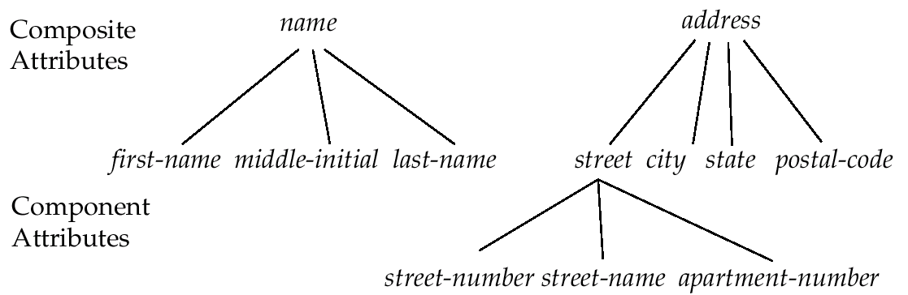

Slide 45
Types of Attributes
Simple attribute − Simple attributes are atomic values, which cannot be divided further. For example, a student's phone number is an atomic value of 10 digits.
Composite attribute − Composite attributes are made of more than one simple attribute. For example, a student's complete name may have first_name and last_name.
Derived attribute − Derived attributes are the attributes that do not exist in the physical database, but their values are derived from other attributes present in the database. For example, average_salary in a department should not be saved directly in the database, instead it can be derived. For another example, age can be derived from data_of_birth.
Single-value attribute − Single-value attributes contain single value. For example − Social_Security_Number.
Multi-value attribute − Multi-value attributes may contain more than one values. For example, a person can have more than one phone number, email_address, etc.

Slide 46
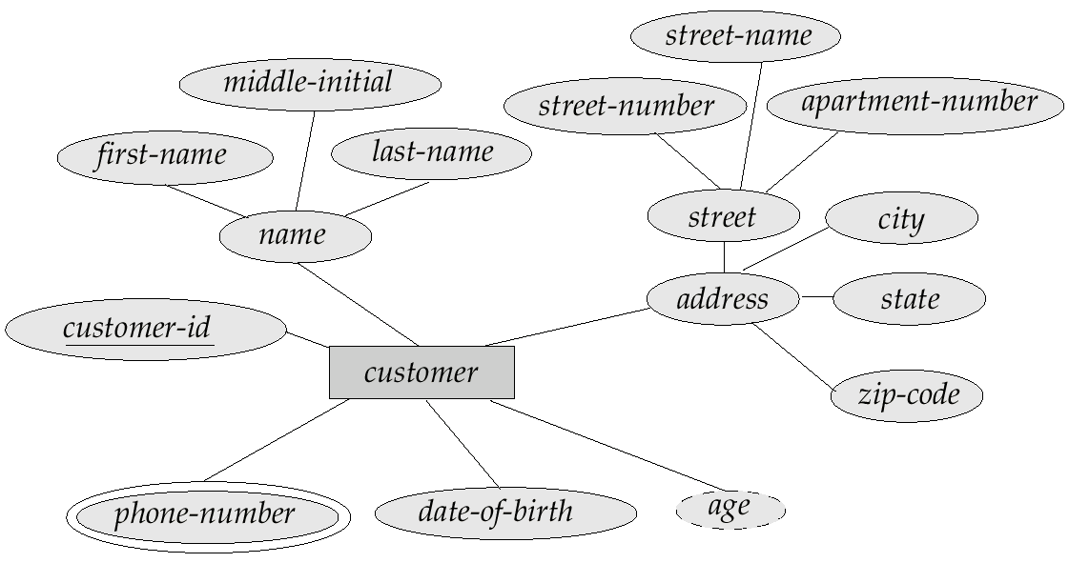

Slide 47
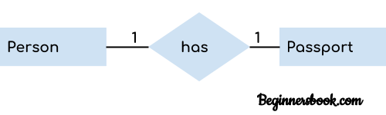
Constraints
Mapping Cardinalities
Participation Constraints
Mapping Cardinality defines the number of entities in one entity set, which can be associated with the number of entities of other set via relationship set.
One-to-one − One entity from entity set A can be associated with at most one entity of entity set B and vice versa.
One-to-many − One entity from entity set A can be associated with more than one entities of entity set B however an entity from entity set B, can be associated with at most one entity.

Slide 48
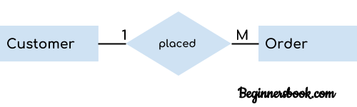
one to many
Many-to-one − one entity from entity set A can be associated with at most one entity of entity set B, however an entity from entity set B can be associated with more than one entity from entity set A.

Slide 49
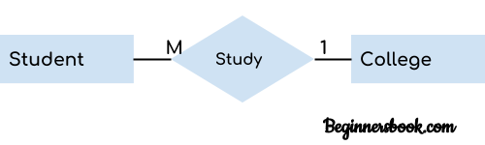
Many to one
.

Slide 50
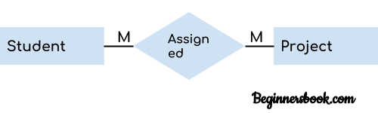
Many to Many Relationship
When more than one instances of an entity is associated with more than one instances of another entity then it is called many to many relationship

Slide 51
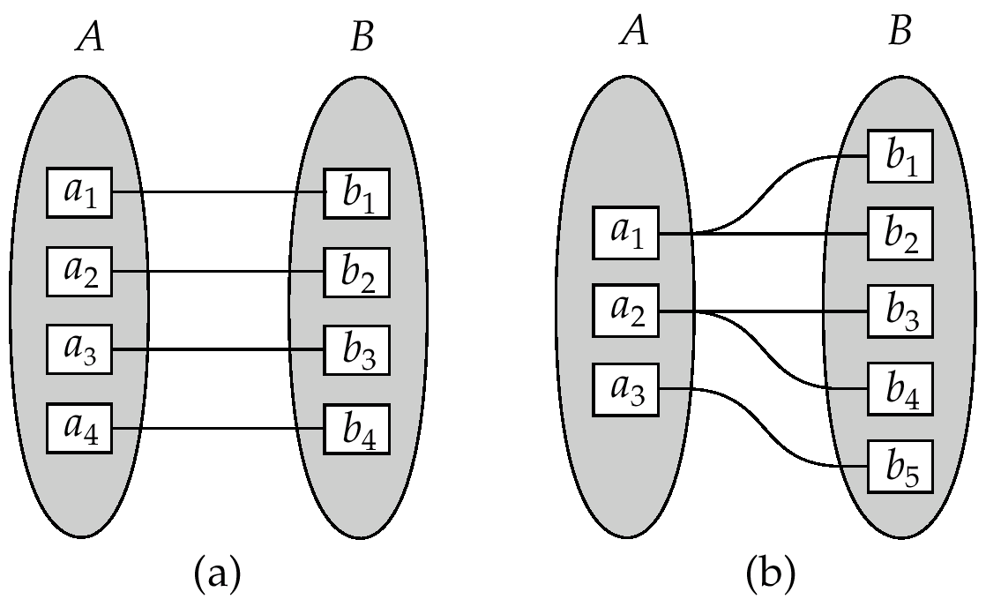

Slide 52
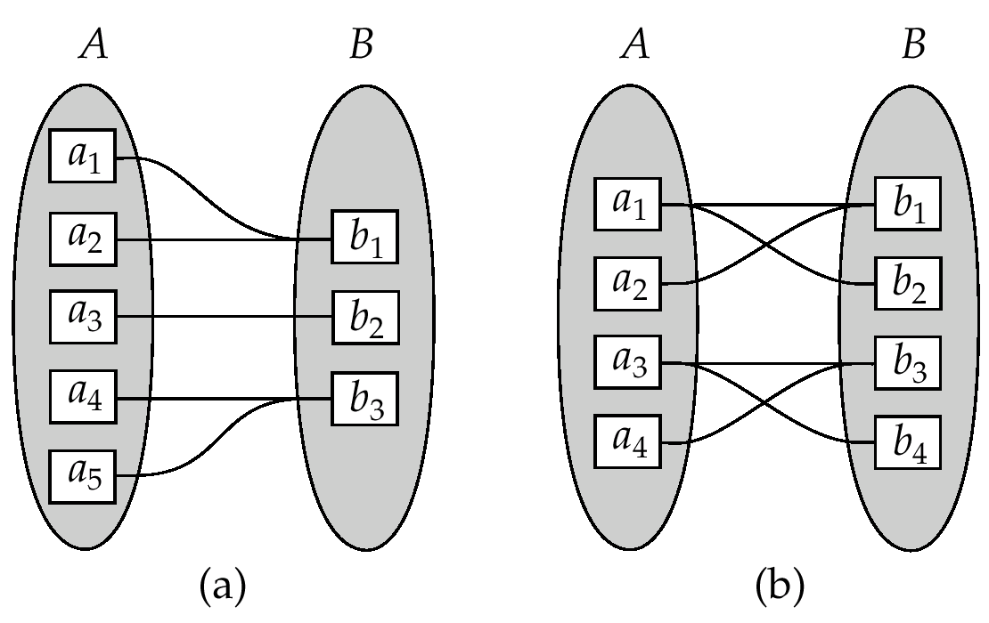

Slide 53
Participation of an Entity Set in a Relationship Set
Total participation (indicated by double line): every entity in the entity set participates in at least one relationship in the relationship set
E.g. participation of loan in borrower is total
every loan must have a customer associated to it via borrower
Partial participation: some entities may not participate in any relationship in the relationship set
E.g. participation of customer in borrower is partial

Slide 54
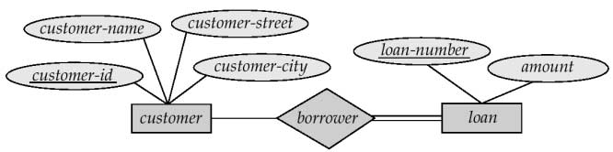
Paticipation of an Entity set in a Relationship Set

Slide 55
Entity’s Role
The function that an Entity plays in a relationship is called entity’s role.
Roles are indicated in E-R diagrams by labeling the lines that connect diamonds to rectangles.
Role labels are optional, and are used to clarify semantics of the relationship.
Eg:The labels “manager” and “worker” are called roles; they specify how employee entities interact via the works-for relationship set.

Slide 56
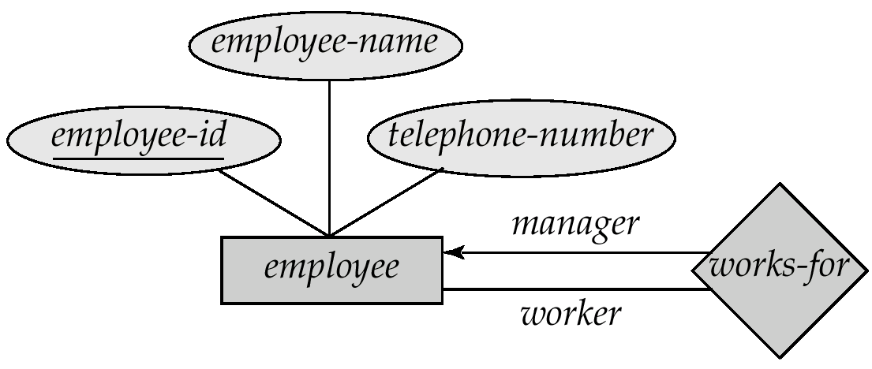

Slide 57
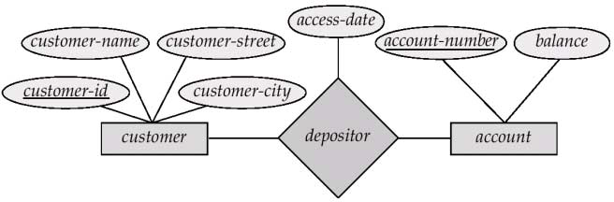
Relationship Sets with Attributes
A relationship with attributes are termed as descriptive attributes.

Slide 58
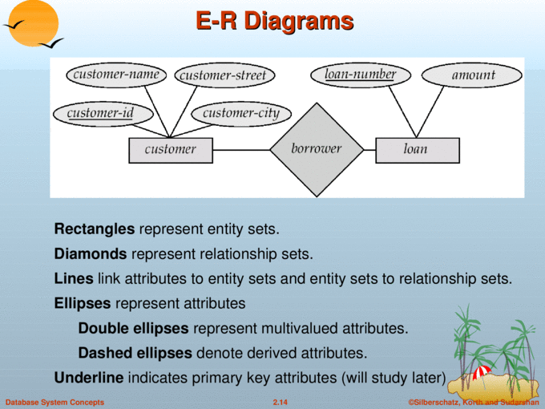

Slide 59
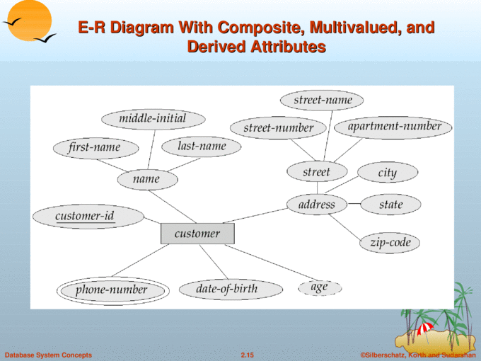

Slide 60
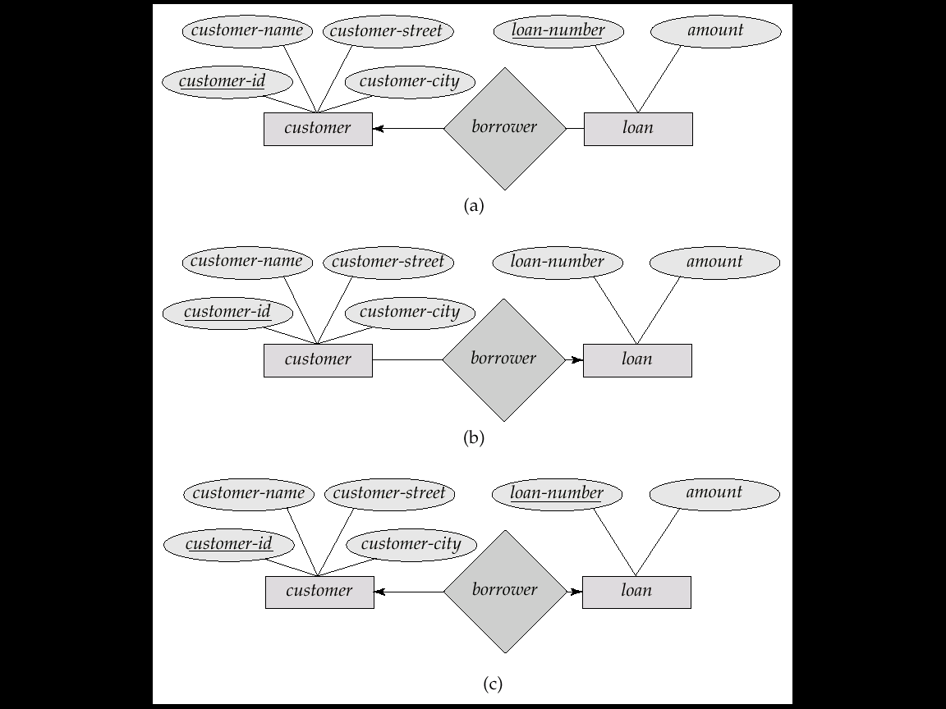
Cardinality Relationship
One-to-one relationship:
A customer is associated with at most one loan via the relationship borrower
A loan is associated with at most one customer via borrower

Slide 61
One-To-Many Relationship
In the one-to-many relationship a loan is associated with at most one customer via borrower, a customer is associated with several (including 0) loans via borrower

Slide 62
Many-To-One Relationships
In a many-to-one relationship a loan is associated with several (including 0) customers via borrower, a customer is associated with at most one loan via borrower

Slide 63
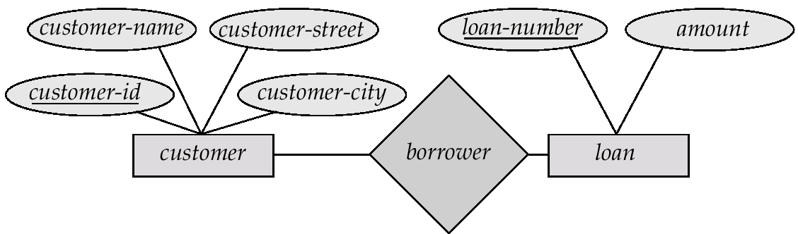
Many-To-Many Relationship
A customer is associated with several (possibly 0) loans via borrower
A loan is associated with several (possibly 0) customers via borrower

Slide 64
Weak Entity Sets
An entity set that does not have a primary key is referred to as a weak entity set.
An entity set that has a primary key are termed as Strong entity set.
For a weak entity set to be meaningful,it must be associated with another entity set called the identifying or owner entity set.
The weak entity set is said to be existence dependent on the identifying entity set.The relationship associating the weak entity set with the identifying entity set is called the identifying relationship.
The discriminator of a weak entity set is the set of attributes that distinguishes among all the entities of a weak entity set.
For example,consider the entity set payment,which has three attributes,payment-number,payment-date and payment amount.Payment numbers are typically sequential numbers,generated separately for each loan.Thus,although each payment entity is distinct,payments for different loans may share the same payment numbers.So,it cant act as a primary key.
The primary key of a weak entity set is formed by the primary key of the strong entity set on which the weak entity set is existence dependent, plus the weak entity set’s discriminator.

Slide 65
We depict a weak entity set by double rectangles and identifying relationship as double diamonds.
We underline the discriminator of a weak entity set with a dashed line.
payment-number – discriminator of the payment entity set
Primary key for payment – (loan-number, payment-number)

Slide 66
A weak entity set can participate in relationship other than the identifying entity set.For example,the payment entity set could participate in a relationship with another weak entity set.

Slide 67
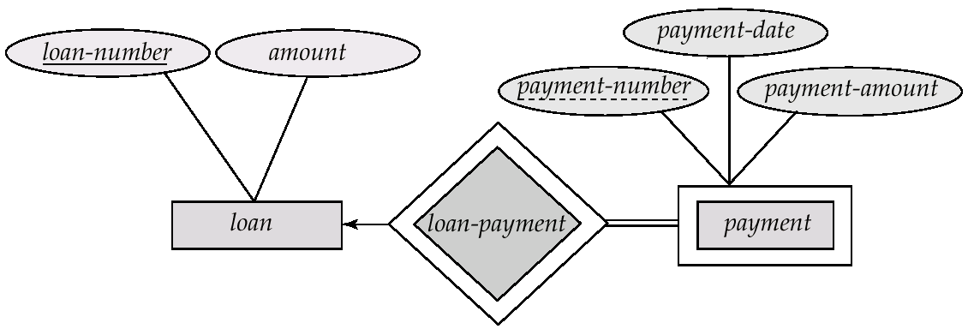

Slide 68
Extended E-R features
Specialisation
An entity set may include subgroupings of entities ,that are distinct in some way from other entities in the set.
Consider an entity set person,with attributes name,street and city.A person may be further classified into

Slide 69
Custiomer
Employee
Each of these person types is described by a set of attributes that includes all the attributes plus some additional attributes
The process of designating subgroupings withan entity set is called specialisation
Generalisation represents a top down design process.

Slide 70
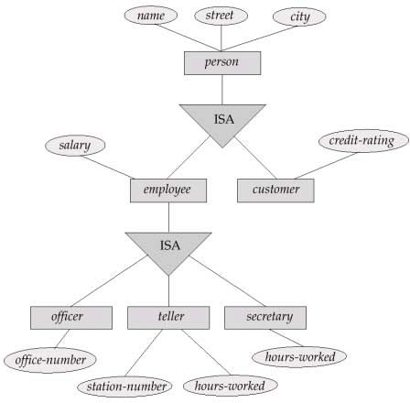
Specialization and Generalization

Slide 71
Generalisation
Multiple entity sets are synthesised into higher level entity set on the basis of some common features.
There are similarities between the customer entity set and the employee entityset in the sense that they have several attributes in common.The commonality can be expressed by generalisation,which is a relationship that exist between higher level entity set and one or more lowe level entity set.

Slide 72
Differences
Specialisation stems from a single entity set where as Generalisation stems from multiple entity sets.
Specialisation is focused on differences whereas Generalisation concentrates on common features.
Specialisation poceeds in a top down manne,but Generalisation proceeds in a Bottom-up manner.

Slide 73
Design Constraints on a Specialization/Generalization
condition-defined-membeship is evaluated on the basis of whether it satisfies a particular condition or not
user-defined-it is purely defined by the user
The lower level entities may be
Disjoint
an entity can belong to only one lower-level entity set
Eg-an entity ,may belong to either a savings account or an checking account
Overlapping
An entity can belong to more than one lower-level entity set.Eg-In employee entity set,certain managers work in more than one team entity set.

Slide 74
Design Constraints on a Specialization/Generalization (Contd.)
Completeness constraint -- specifies whether or not an entity in the higher-level entity set must belong to at least one of the lower-level entity sets within a generalization.
total : an entity must belong to one of the lower-level entity sets
partial: an entity need not belong to one of the lower-level entity sets.

